Slide 1
MIKE 11
Coupling RR with HD through the River Network
Rainfall Runoff (RR) Modelling

Slide 2
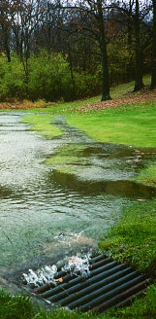
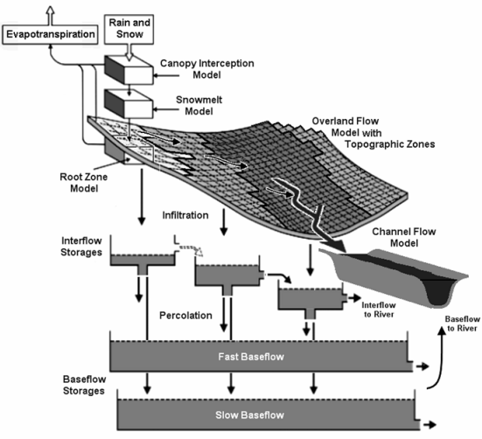
Coupling RR-HD

Slide 3
Coupling RR-HD
MODELS AVAILABLE:
NAM – daily or hourly, with surface & subsurface interflow & storages, nine cal. Parameters
SMAP – monthly, with two storages, five cal. parameters (similar accuracy to monthly NAM)
UHM – unit hydrograph method using SCS or user defined curves and SCS or standard loss models
Urban – two methods: time/area or non-linear reservoir
FEH – UK Flood Estimation Handbook, with design or observed flood events
DRiFt – DEM-based morphological model developed by CIMA (Italian research cooperative)

Slide 4
Coupling RR-HD
Basic principles :
Using the rainfall runoff module as boundary condition for the hydrodynamics
Coupling at branch ends
Coupling along reaches
Ensuring that the hydrodynamic setup is well defined

Slide 5
Coupling RR-HD
The physical system
C1
4 catchments
1 main stream
3 tributaries
1 higher order branch
C2
C3
C4
How do we represent this in the model?

Slide 6
Coupling RR-HD
The Rainfall Runoff system
Model each sub- catchment separately
May use same set of parameters for all 4
Subdivision to ensure timing in HD correct
C1
C3
C2
C4

Slide 7
Coupling RR-HD
The Hydrodynamic system
Set up the hydrodynamics
Stand alone
Background flow
Boundary conditions for all free branch ends
Please ensure that the hydrodynamic system is sound
Must be able to run without Rainfall Runoff input

Slide 8
Coupling RR-HD
Coupling the two systems
C1
Runoff may be coupled
as a point source
as a distributed source
C2
C3
C4
How do we couple the same catchment to multiple branches?

Slide 9
Coupling RR-HD
One catchment to multiple branches
A1_{C3}
A1_{C3}+ A2_{C3}=A_{C3}
C3
A2_{C3}
Runoff may be distributed over multiple branches by catchment area weighting

Slide 10
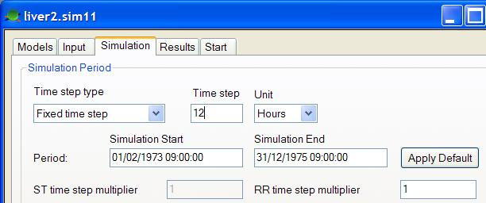
Coupling RR-HD
IMPLEMENTATION :
Solution A : RR coupled to HD model (simultaneous simulations)
Tick both HD and RR
Specify a RR11 model file
MULTIPLE OF HD TIME STEP

Slide 11
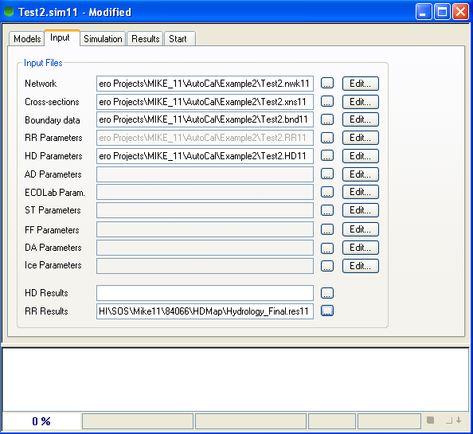
Coupling RR-HD
IMPLEMENTATION :
Solution B : Independent simulations
Specify previous RR results on Input page

Slide 12
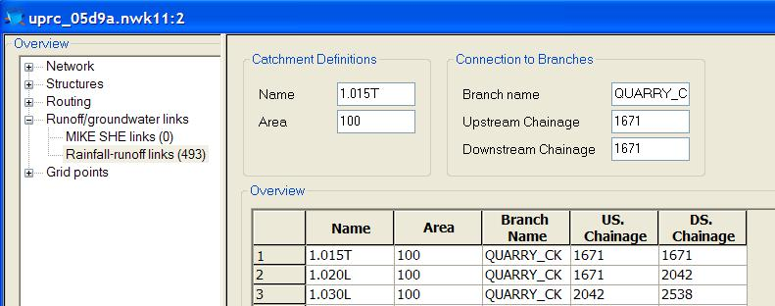
Coupling RR-HD
Links defined in the Network file :
Two ways of coupling :
Point source
Distributed source
For multiple branches in a catchment, distribute by catchment area weighting

